Slide 1

GRAPHS AND FUNCTIONS
16th SEPT 2026

Slide 2
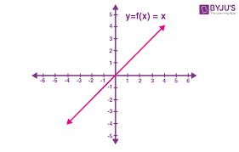
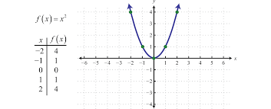
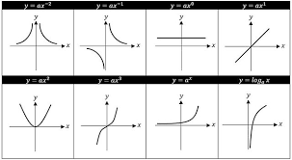
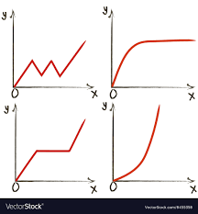

Slide 3
Functions
A function in mathematics is defined as the relationship between a given set of inputs (X_{i}) and the output (Y).
Broadly defined, it’s a relationship between variables. Each of the inputs- X_{i} is related to exactly one output.
A function is usually represented as Y= f(X) where X is the input and Y or f(X) is the output. Y can also be called the codomain/ dependent variable and X the domain/ independent variable(s).

Slide 4
Functions (Ct’d)
For example; Given the function below;
Y= 3+X,
for X= 1; Y= 3+ X = 3+1=4
for X= -2; Y= 3+ X = 3+(⁻2) = 3-2= 1
From the above function; it is evident that each input (X) has only one particular output (Y).
There are various types of functions used in mathematics; we shall look at some of them in the slides below;

Slide 5
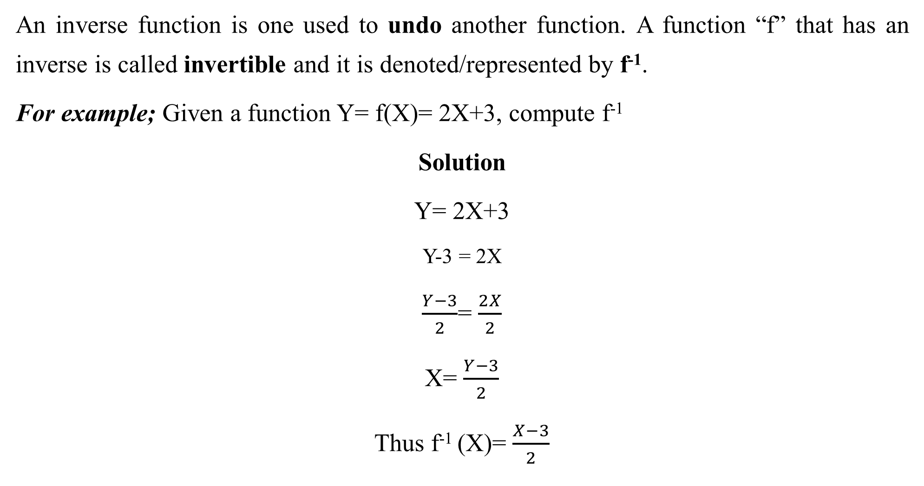
Inverse functions
An inverse function is one used to undo another function. A function “f” that has an inverse is called invertible and it is denoted/represented by f⁻¹.
For example; Given a function Y= f(X)= 2X+3, compute f⁻¹
Solution
Y= 2X+3
Y-3 = 2X
$\frac{Y−3}{2}$= $\frac{2X}{2}$
X= $\frac{Y−3}{2}$
Thus f⁻¹ (X)= $\frac{X−3}{2}$

Slide 6
Inverse functions (Ct’d)
NOTE: If the function f is a set of order pairs (X, Y), then the inverse of f is the set of ordered pairs (Y, X).
Exercise: Compute the inverse of Y=f(x)= 2+4X. Sketch both f and f⁻¹ on the same graph. What are your observations?

Slide 7
Linear functions
The general formula of a linear function is;
Y= a + bX_{i}; where
a is the intercept (the value of Y when all other factors/inputs (X_{i}) are zero)
b is the coefficient/Slope (the change in Y when a factor/input (X) changes by 1 unit)
NOTE: For a linear function, the independent variable (X) is to the power of utmost one (1); that is, the power of X is either one or zero.

Slide 8
Graphs/Fitting linear functions
To plot a graph of a linear function, we compute the values of Y for each value of X. By doing this, we generate different coordinates (X_{i},Y_{i}) that we can plot/fit on a graph.
For example
Given the linear function Y= 3+X; use it to generate a graph.

Slide 9
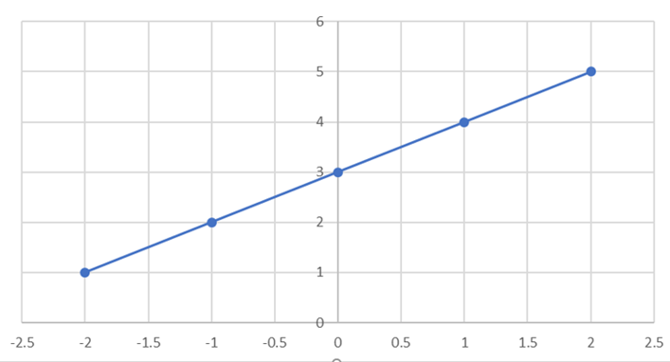
Solution
Using different values of X say; -2, -1, 0, 1, 2; you can compute the values of Y to get the different coordinates to plot on the graph as in the table below
The above coordinates in the table can be fitted on a graph as shown on the side;
Income (X) | -2 | -1 | 0 | 1 | 2
Investment (Y) | 1 | 2 | 3 | 4 | 5
Coordinates (X, Y) | -2,1 | -1,2 | 0,3 | 1,4 | 2,5

Slide 10
Intercept
It is the value of Y when X (Xs) is/are Zero(0) holding other factors constant.
For example; Given that Y = 3 + 4X; Where Y is Investment and X is Income
The intercept of 3 implies that;
Y= 3 + 4(0) = 3
Thus, Investment (Y) is 3 units when Income (X) is 0 holding other factors constant.

Slide 11
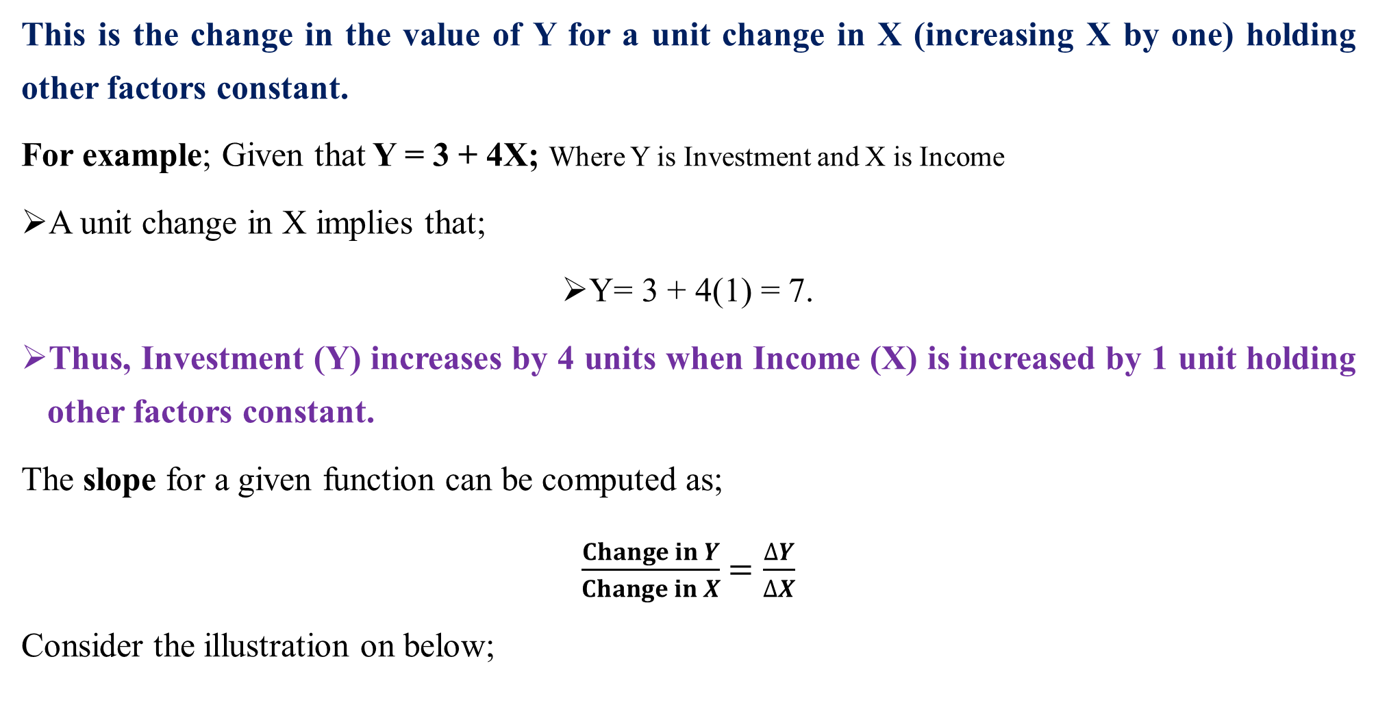
Slope
This is the change in the value of Y for a unit change in X (increasing X by one) holding other factors constant.
For example; Given that Y = 3 + 4X; Where Y is Investment and X is Income
A unit change in X implies that;
Y= 3 + 4(1) = 7.
Thus, Investment (Y) increases by 4 units when Income (X) is increased by 1 unit holding other factors constant.
The slope for a given function can be computed as;
$\frac{Change in Y}{Change in X}$ $=\frac{∆Y}{∆X}$
Consider the illustration on below;

Slide 12
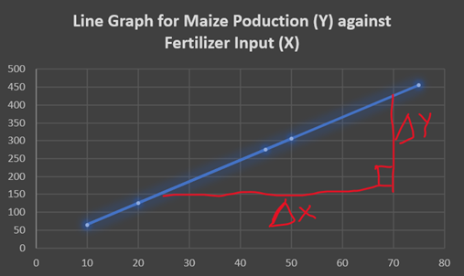
Slope (Ctd)
This graph shows a positive slope of maize production and fertilizer application.

Slide 13
Non-linear functions
A non-linear function is one that isn’t linear in nature. This implies that the function doesn’t change smoothly for different values X; the slopes keep on changing. The graph of linear functions changes direction abruptly.
A non-linear function doesn’t graph into a straight line and its slope isn’t constant.
The independent variables (or even the dependent variable) in this type of function have a power that is neither 0 nor 1 ie the X_{s} have powers that are more than 1.
So, to identify a nonlinear function, look for one whose variables have 2 or more as a power.

Slide 14
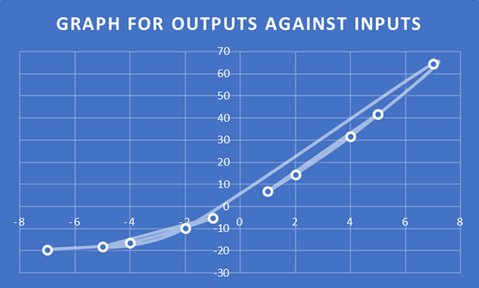
Non-linear functions (Ct’d)
For example;
Y² = 1- X²
Y= 2+ 0.3X³
Consider the nonlinear function; Y= 5+ 6X + 0.45 X², it can be graphed as;

Slide 15
Composite functions
These are functions whose outputs are used as inputs of another function.
Assuming we have two functions, “f” and another “g”; the function f g (x) also known as f o g is the composition of two functions.
By substituting one function into another, you get a composite function.
The order of substituting these functions is very IMPORTANT as one comes before the other(s).

Slide 16
Composite functions (Ct’d)
For example; Given that f(X)= 3+4X and g(X)= 1-2X+X²; find the composite function f[g(X)]or fog(x). Evaluate its value if X=3.
Solution
f(X)= 3+4X and g(X)= 1-2X+X²
f[g(X)]/fg(x) = 3 +4 (1-2X+X²)
=3 + 4- 8X+ 4X²
=7- 8X+ 4X²
Thus for fg(3) = 7- 8X+ 4X² ⁼ [7- (8*3)+ (4*3*3)] = 19

Slide 17
Using Excel to plot functions
To plot functions using excel follow the following steps;
Using a given function say Y= 5+ 6X, compute the values of Y for the different Xi to generate the coordinates to plot. Refer to slide 7
Create a table for the different values (coordinates) of X and Y
Fertilizer (X) | -2 | -1 | 0 | 1 | 2
Maize Pdn (Y) | 1 | 2 | 3 | 4 | 5
Coordinates (X, Y) | -2,1 | -1,2 | 0,3 | 1,4 | 2,5
3. Draw the graph
Open excel
Insert
Insert Scatter (check through the different charts)

Slide 18
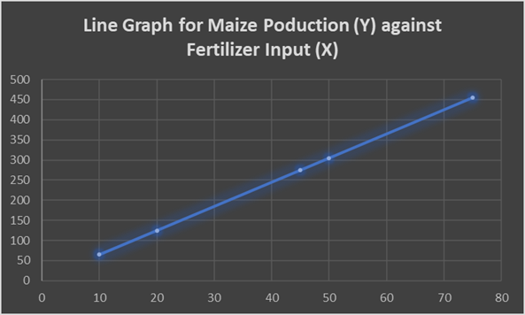

Slide 19
References
For more details on how to plot functions using Excel, follow the link below;
https://www.youtube.com/watch?v=FxeuBzVNxrU
Using Excel to plot functions.xlsx

Slide 20
Functions with two independent variables
Functions can have more than one independent variable such as in the model below;
Y=a + b₁X₁ + b₂X₂ + b₃X₃ + b₄X_{4 ……} b_{n}X_{n} + µ
Where;
Y – Dependent Variable
X_{i} are the independent variables
n is the number of independent variables
µ is the error term

Slide 21
Functions with two independent variables (Ct’d)
For emphasis; let us consider the real-life function below with two independent variables;
Qty of Maize Produced = 50 + 0.45Acres of land Cultivated + 0.5 Qty of Fertilizer Applied
Explanation of the function
50- These are the units of maize produced when all the other factor inputs (X_{s}) are zero.
0.45- A unit increase in the number of acres cultivated leads to an increase in maize produced by 0.45 holding other factors constant
0.5- A unit increase in the quantity of fertilizer applied leads to an increase in maize produced by 0.5 holding other factors constant

Slide 22
Agricultural Application and solving related problems
Functions are used for several purposes in Agriculture. Some of them include;
They are mainly used to estimate the relationships between different variables. For example, the relationship between the fertilizer application and production of a given good. This can be done through estimating a simple linear regression model/function or plotting a graph.
They can also be used for estimating/predicting future trends. Eg given sales values, a farmer can predict his or her income.

Slide 23
R
EXCERCISE
Using the linear function; Expenditure = 0.6 + 0.3 Income;
Identify the slope and the intercept. Explain both of them.
Use the function to plot a graph of Expenditure against Income
Evaluate/Predict the value of expenditure given that Income is 300,000 UGX

Slide 24

Thank you
@ASK

